Slide 1

School of CS & AI, SR University
Course Code | Course Title | L | R | P | Cr
23CS201PC302 | Software Engineering and System Design | 2 | 0 | 2 | 3
Program Core
Lab Experiments
1. Requirements and User Stories 2. UML Modeling 3. Git Basics and Individual Workflow 4. Git Collaboration: Branching and Merging 5. Agile/Scrum Simulation 6. Implementing Design Patterns I -Creational 7. Implementing Design Patterns II -Behavioral 8. UNIT Testing with JUNIT/pytest 9. CI/CD Pipeline 10. API Interaction 11. System Design Diagramming 12. Exploring Scalability Components -Conceptual
Lab- 3 (week 3)
Git Collaboration: Branching and Merging
Prepared by
Dr. K. Rajchandar
Assistant Professor

Slide 2
Lab Objectives
S Learning Objectives – Branching & Merging
🌿 Understand Branching – Create and manage multiple branches for parallel development.
🔀 Learn Merging – Combine changes from different branches into a main codebase.
🛠 Simulate Team Collaboration – Work on features independently without affecting main project.
🧑‍💻 Resolve Conflicts – Gain skills in handling merge conflicts effectively.
🚀 Hands-on Practice – Apply Git commands and GitHub workflow for real projects.

Slide 3
🧠 Learning Outcomes
Learning Outcomes – Branching & Merging
✅ Ability to create, switch, and delete branches in Git & GitHub.
✅ Successfully merge feature branches into main/master.
✅ Experience in resolving merge conflicts and ensuring smooth integration.
✅ Confidence in using GitHub as a collaborative platform.
✅ Preparedness for real-world software engineering practices in teamwork.

Slide 4
Branching
1. A branch is like creating a separate workspace where you can make changes without affecting the live site.
Your current branch is master (the default where your live GitHub Pages site runs from).
If you make changes directly on master, they go live immediately after pushing.
If you create a new branch (say, add-profile-image), you can add the image and test it before merging to master.

Slide 5
Branching
Branching in Git & GitHub
📌 Definition
A branch is like a separate workspace in your project.
It allows you to develop features, fix bugs, or experiment without affecting the main code.
📌 Why Branching?
Work independently on new ideas.
Keep main (or master) branch stable.
Multiple team members can work in parallel.
📌 Example:
main branch → stable website.
feature/about branch → adding "About Me" section.
feature/projects branch → adding "Projects" section.

Slide 6
Merging in Git & GitHub
📌 Definition
Merging combines the changes from one branch into another (e.g., feature → main).
Ensures all updates are brought together.
📌 Types of Merge:
Fast-forward merge → if no conflict.
Merge commit → if multiple changes exist.

Slide 7
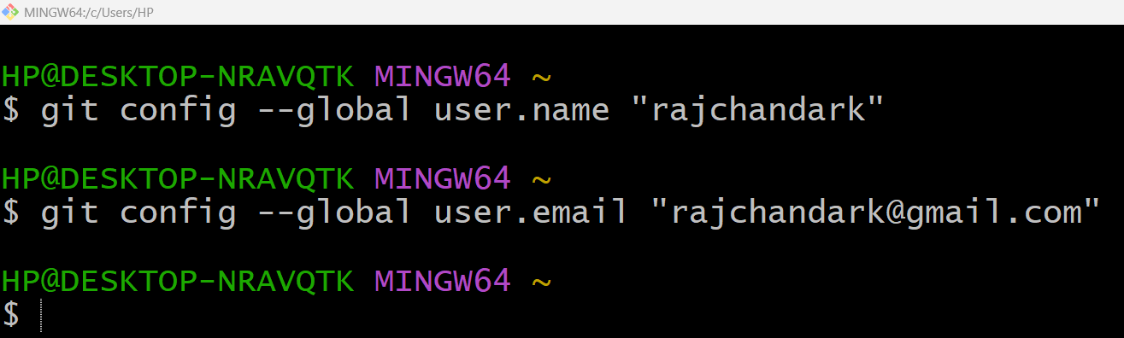
Step 1

Slide 8
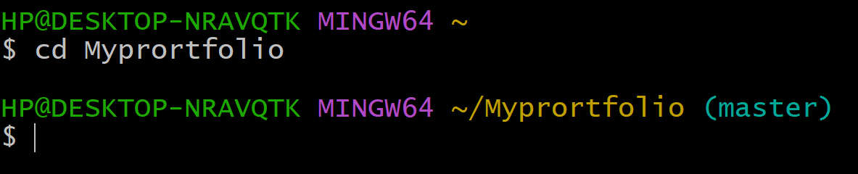
Step 2

Slide 9
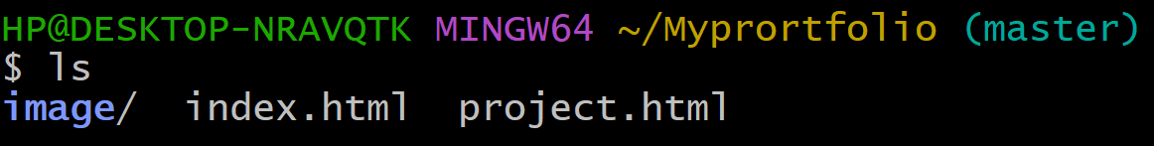
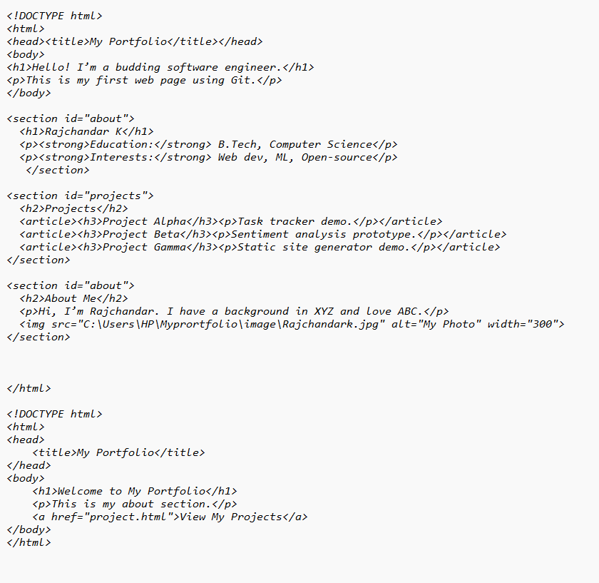
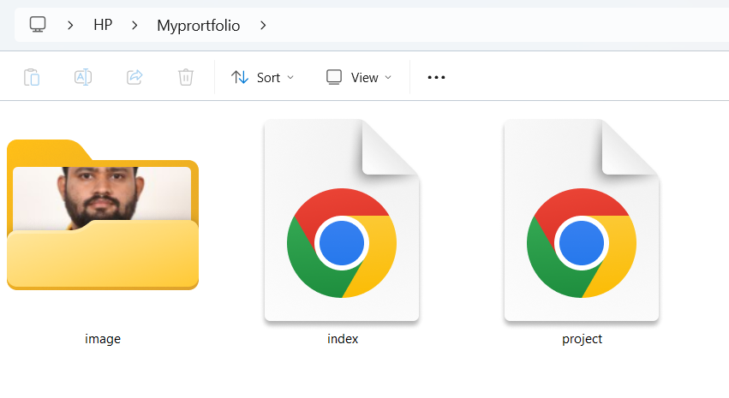
Add new HTML file

Slide 10
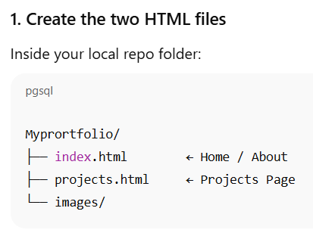
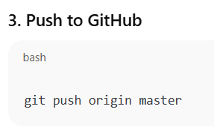
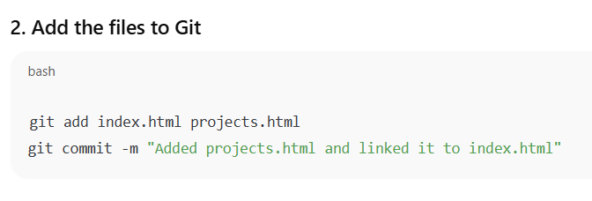
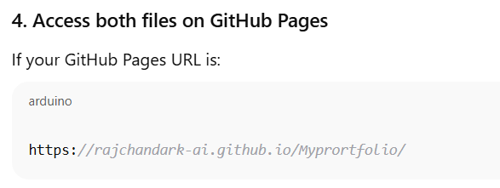
Steps

Slide 11
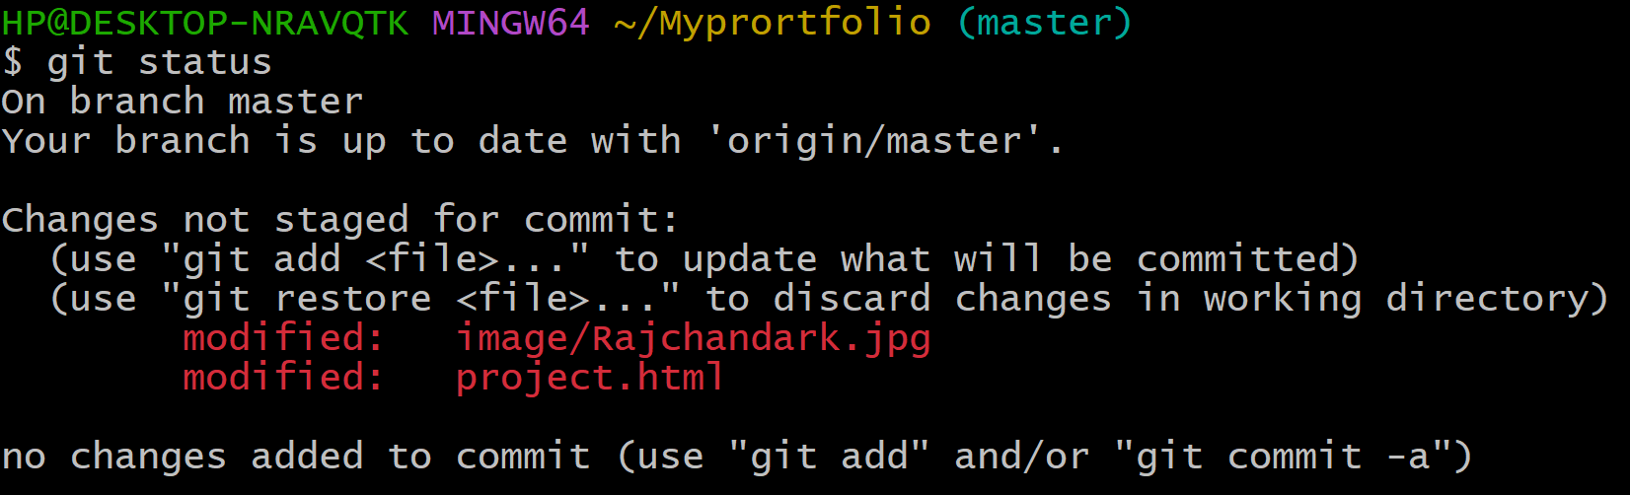

Slide 12

End of Assignment 4

Slide 13
Software Engineering
🏗️ Git is Essential For:
Managing team collaboration
Applying Agile and DevOps practices
Tracking requirements and features
Ensuring quality, reproducibility, and auditability
🚀 Real-World Example: When working on a project like a mobile app, Git lets each developer contribute code without disrupting others. One can add a new login feature while another fixes a bug, all without conflict — thanks to Git's branching and merging.

Slide 14
Git Basics & Individual Workflow
Git Basics | Individual Workflow
Git tracks code changes | You’re the sole contributor
Key commands: init, commit, push, pull, merge | No merge conflicts, minimal branching needed
Repos: Local & GitHub | Used in personal portfolios, labs, or solo projects
Track project history | Helps learn Git before moving to team-based (collaborative) Git
👤 What is Individual Workflow in Git?
Individual workflow means you're working alone on a Git project without collaborating with a team.
🧩 Features of Individual Workflow:
You work independently on a single repo (typically on GitHub).
You are the only one pushing, committing, and merging changes.
Useful for personal projects, assignments, or learning Git.

Slide 15
✅ Basics of Git:
Git is a distributed version control system used to manage and track changes in code collaboratively or individually.
Concept | Description
Repository (repo) | A folder that Git tracks (local or remote).
Commit | A snapshot of your project at a particular point in time.
Branch | A separate line of development; commonly used for features or experiments.
Merge | Combines changes from one branch into another (e.g., from feature to main).
Clone | Downloading a remote repo to your local machine.
Pull | Fetching changes from the remote repository to your local one.
Push | Sending your committed changes from your local repo to a remote repo.
Status | Shows the current state of your working directory.
Diff | Shows differences between versions of files.
Log | Displays the commit history.
Init | Initializes a new Git repository.
.gitignore | A file that tells Git which files/folders to ignore.

Slide 16
Assignment 4
📚 Pre-requisites for Students:
Install Git and basic text editor (VS Code or Notepad++).
GitHub account created and accessible.
Basic understanding of command line/terminal.
🧪 Lab Setup:
Requirement | Details
Software | Git (installed locally), VS Code (optional)
Platform | GitHub (online) or GitLab
Duration | 2 hours

Slide 17
✅ What is Git?
Git is a distributed version control system used to track changes in source code during software development. It allows multiple developers to collaborate efficiently while maintaining the integrity and history of the project.
🔑 Feature | 💡 Explanation
Version Control | Git keeps track of every change made to code. You can revert to previous versions easily.
Collaboration | Multiple developers can work on the same project simultaneously without overwriting each other’s work.
Branching & Merging | Developers can create branches to work on features or fixes independently and merge them back once tested.
Backup & Recovery | Code is backed up in remote repositories like GitHub/GitLab, making it safe and recoverable.
Traceability | Every change is recorded with a message and timestamp. You can see who made what change and why.
Open Source & Widely Used | Git is free, open source, and the standard tool in the software industry.

Slide 18
🏗️ In Software Engineering, Git is Essential For:
Managing team collaboration
Applying Agile and DevOps practices
Tracking requirements and features
Ensuring quality, reproducibility, and auditability

Slide 19
🧪 Git Activity Case Study
🎯 Case Study Title: "MyPortfolio Web Page“
🧑‍🎓 Objective: Learn Git basics by creating and tracking a personal web portfolio (single HTML file) using Git and GitHub.

Slide 20
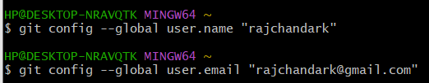
🪜 Step-by-Step Procedure (Git + GitHub)
📍STEP 1: Install Git (One-time setup)
Download Git: https://git-scm.com/downloads
Install with default settings.
📍STEP 2: Configure Git
git config --global user.name "Your Name"
git config --global user.email "you@example.com"

Slide 21
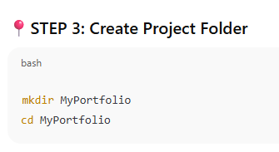

Create folder in GIT

Slide 22
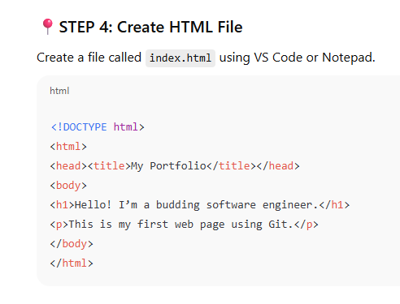
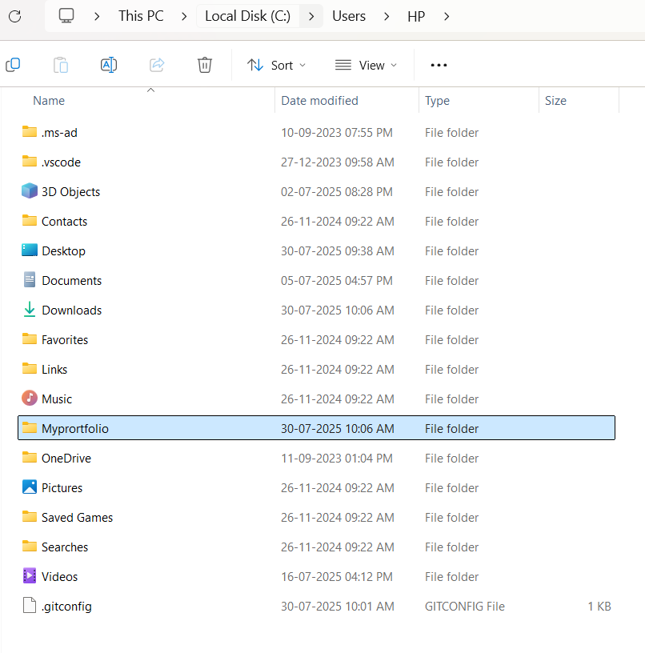
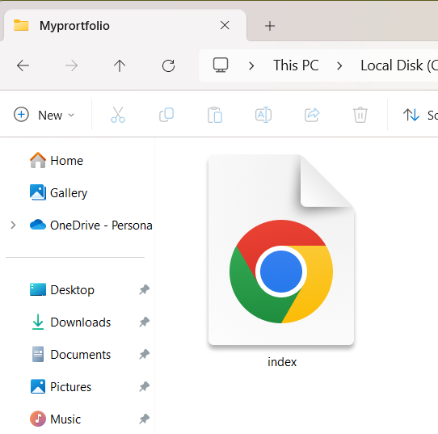
Create HTML file

Slide 23
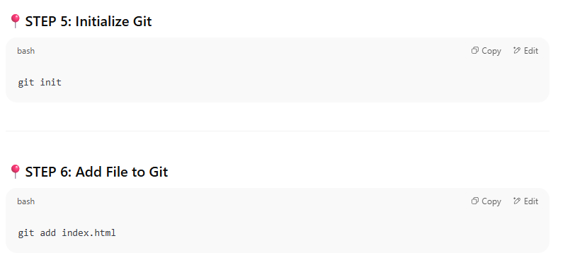


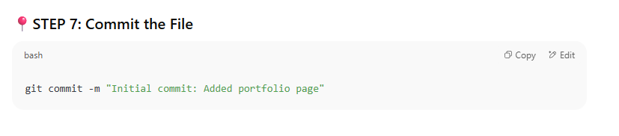

GIT – Commands

Slide 24
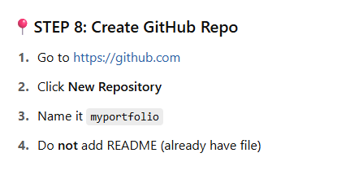
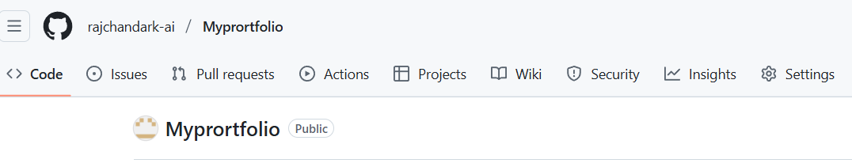
Create a Repository in GIT-HUB

Slide 25
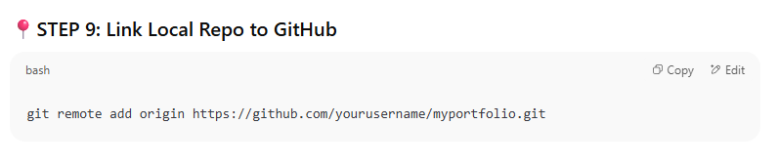
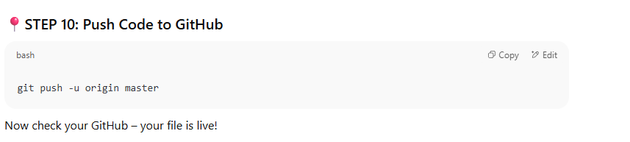
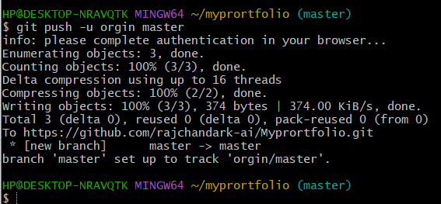
Link remote and Push code to GIT-HUB

Slide 26
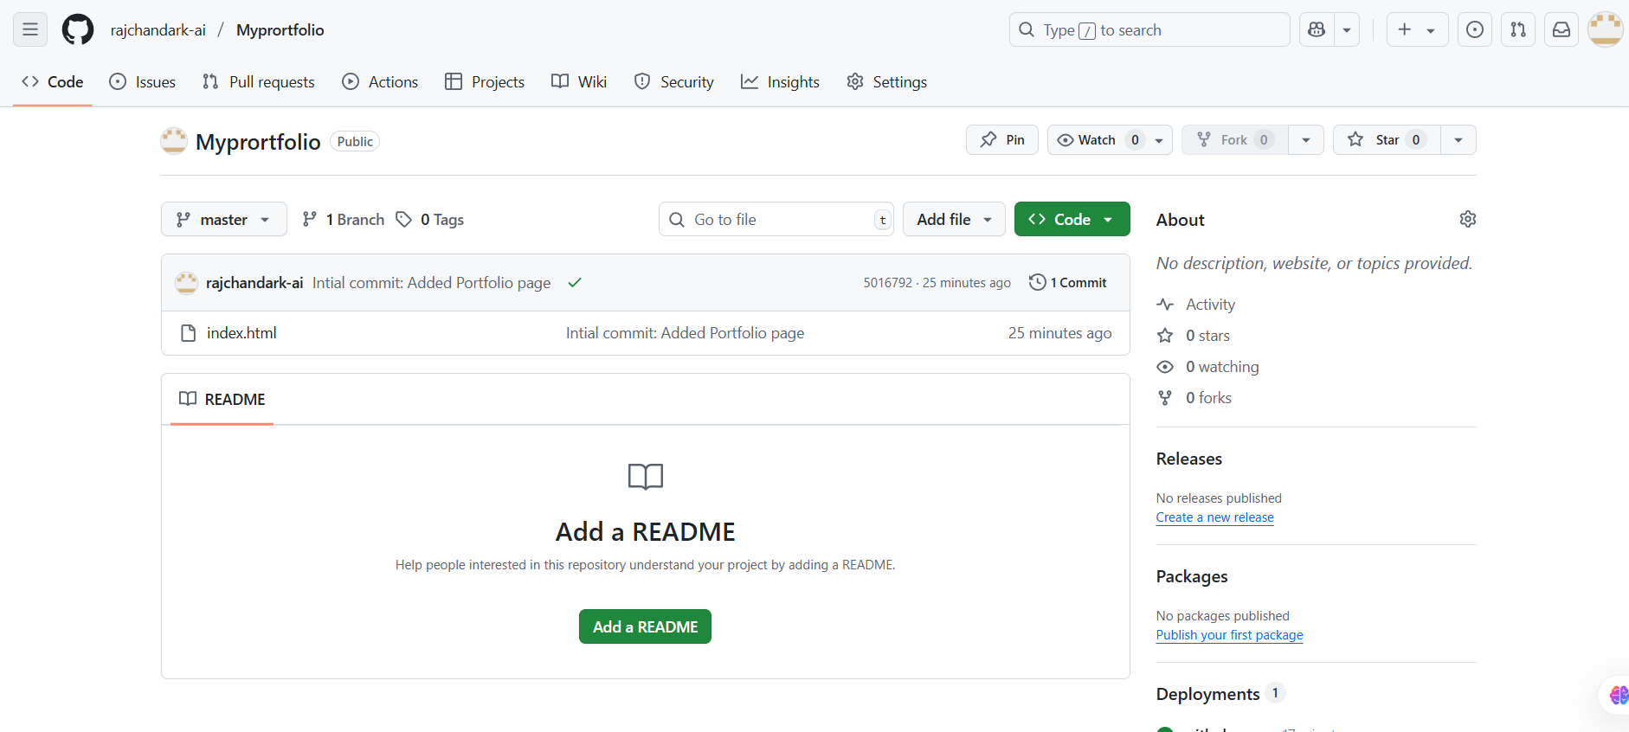
Your repository page at GIT-HUB

Slide 27
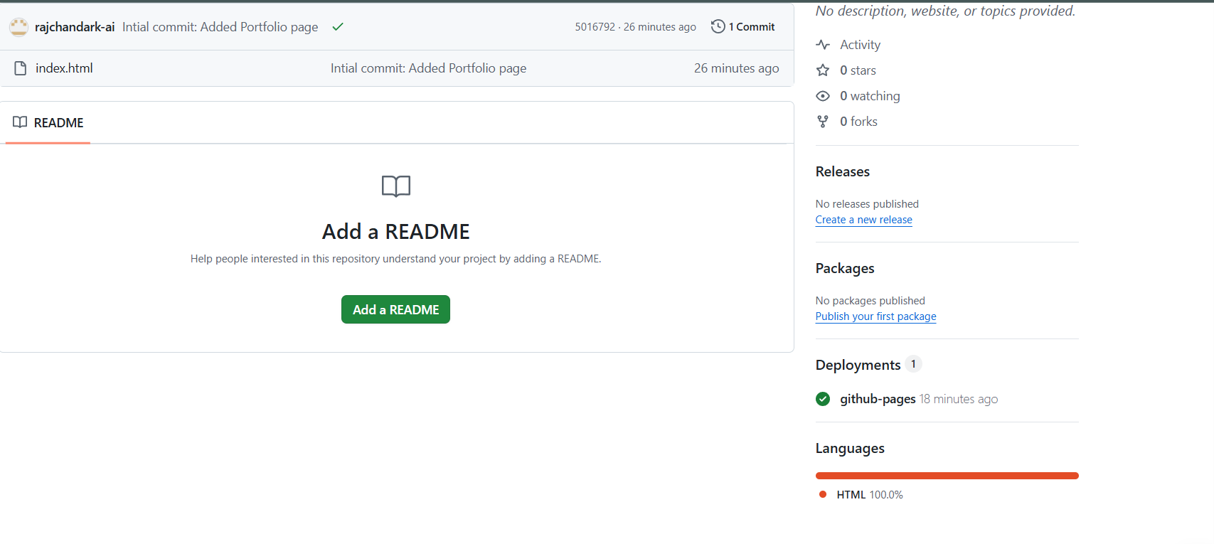
Your Repository Page with Deployment Link
Click Link Deployment

Slide 28
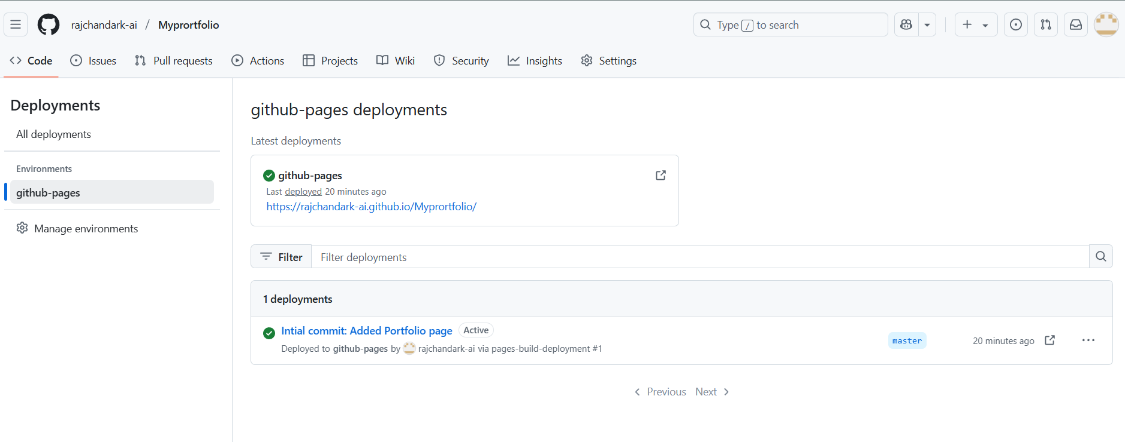
Web page Link
Click the Link in the Deployment page

Slide 29
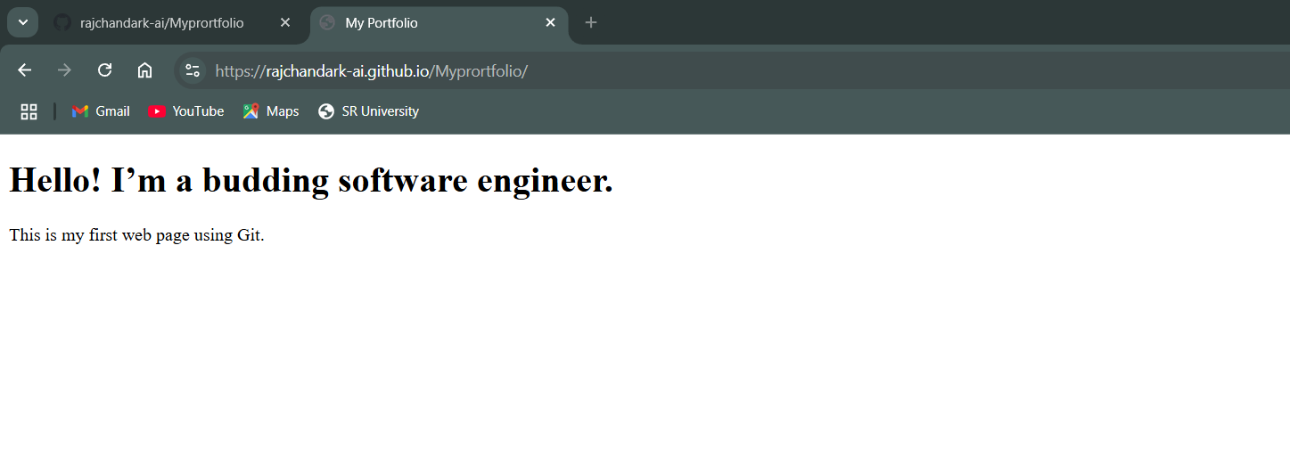
Website is Launched

Slide 30
Hands-on Activities (Step-by-Step)
Step | Activity | Git Command
1 | Initialize a Git Repository | git init
2 | Configure user details | git config --global user.name "Your Name" git config --global user.email "you@example.com"
3 | Create a file (e.g., hello.txt) and write content | Use VS Code or Notepad
4 | Add file to staging area | git add hello.txt
5 | Commit the file | git commit -m "Initial commit"
6 | Check status | git status
7 | View commit log | git log
8 | Modify file and commit again | Add a line → git add . → git commit -m "Updated file"
9 | Create GitHub repo and connect | git remote add origin https://github.com/user/repo.git
10 | Push to GitHub | git push -u origin master

